Slide 1
Zomato Dashboard Project by Priyanka

Slide 2
Problem Statement
India is saturated: 90%+ of Zomato listings are in India.
Question: Where should Zomato open new restaurants outside India?
Goal: Find markets with low competition and high quality.

Slide 3
Data Overview
Dataset: 9,551 Zomato restaurant listings.
Coverage: 15 countries(India has 8,652 listings,the rest have 4 to 434 each).
Time Period: Restaurant openings from 1010 to 2018.
Key Fields: Country,City,Cuisines,Average Cost for Two,Rating.Votes, Price Range,
Online Delivery,Table Booking.
Data Prep: Cleaned and structured in Excel.then analyzed with pivot
tables and charts in the dashboard.

Slide 4
Choosing the next markets
for new restaurant openings
A data-driven review of 9,551 restaurant listings across 15 countries to identify
low-competition, high-quality markets for Zomato's next expansion.

Slide 5
Where should Zomato grow next?
Zomato's core market is heavily concentrated: of 9,551 restaurant listings in the dataset, 8,652 (over 90%) are already in India. Growth in the home market is increasingly a fight over existing demand, while several international markets remain comparatively under-served.
The question Zomato's management needs answered:
Notes:
Zomato's core market is heavily concentrated. Of the 9,551 restaurant listings in our dataset, 8,652, over 90%, are in India This means growth at home is increasingly a fight over existing demand, while many international markets remain under-served. Outside India, no country has more than 434 restaurants, and several have fewer than 25.So the question for management is: where should Zomato grow next? The next slides answer that.

Slide 6
A seven-step framework, from data to decision
Define the problem — Where should Zomato expand outside India?
2. Clean & prepare data — 9,551 listings across 15 countries, structured for analysis
3. Objective analysis — Competition levels & growth trends by country
4. Subjective analysis — Quality, pricing, cuisine, and engagement by market
5. Correlation check — Does price actually drive rating? (0.059 → no)
6. Shortlist markets — Low competition + above-benchmark quality
7. Recommend & conclude — Qatar, Turkey, New Zealand — in that order

Slide 7
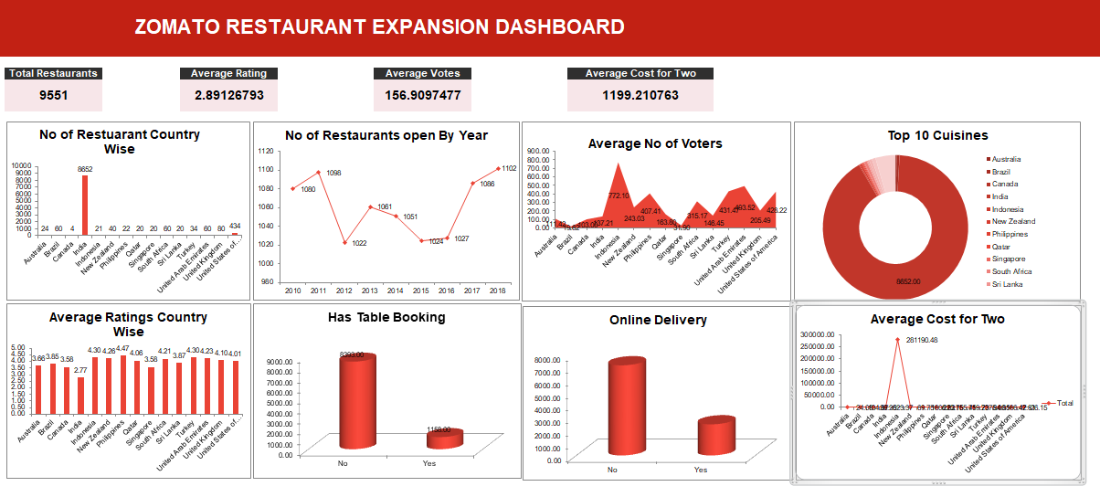
India Dominates, the Rest of the World Is Open
Notes:
his dashboard answers one question: where should Zomato expand next ? We analyzed 9,551 restaurants, with an average rating of 2.89 and about 157 votes each India has 8,652 restaurants, around 90% of the total. Every other country has fewer than 500, so India is saturated while the rest of the world is largely untapped.Restaurant openings dipped to 1,022 in 2012, then recovered and peaked at 1,102 in 2018. Growth is picking up again.Ratings are similar across countries, but customer engagement varies a lot. More votes mean a more active customer base.Most restaurants offer no table booking and no online delivery. This is a clear opportunity for Zomato to add value.Average cost for two differs widely across markets, so pricing needs to be local.Our recommendation: expand into low-competition countries with good ratings, and push online delivery and table booking.

Slide 8
9,551 restaurants, cleaned and ready for analysis
Country | No. Of Restaurant | Average of Votes | Average of Average_Cost_for_two | Average of Rating
Australia | 24 | 111.42 | 24.08 | 3.66
Brazil | 60 | 19.62 | 134.67 | 3.85
Canada | 4 | 103.00 | 36.25 | 3.58
India | 8652 | 137.21 | 623.37 | 2.77
Indonesia | 21 | 772.10 | 281190.48 | 4.30
New Zealand | 40 | 243.03 | 69.75 | 4.26
Philippines | 22 | 407.41 | 1606.82 | 4.47
Qatar | 20 | 163.80 | 223.75 | 4.06
Singapore | 20 | 31.90 | 155.75 | 3.58
South Africa | 60 | 315.17 | 419.73 | 4.21
Sri Lanka | 20 | 146.45 | 2375.00 | 3.87
Turkey | 34 | 431.47 | 84.85 | 4.30
United Arab Emirates | 60 | 493.52 | 166.42 | 4.23
United Kingdom | 80 | 205.49 | 47.81 | 4.10
United States of America | 434 | 428.22 | 26.15 | 4.01
Grand Total | 9551 | 156.91 | 1199.21 | 2.89

Slide 9
Outside India, the USA is Crowded and Many Markets Are Open.
Restaurant count by country — India (8,652) excluded for scale
Notes:
Excluding India, which has 8,652 restaurants, let's see where competition is lowest The USA is the most crowded market with 434 restaurants, far ahead of the UK at 80 and the UAE, South Africa and Brazil at 60 each At the other end, markets like Australia, the Philippines, Indonesia, Sri Lanka, Singapore and Qatar have only 20 to 24 restaurants. Canada has just 4, which is the lowest competition of all The highlighted markets, New Zealand, Turkey and Qatar, are our shortlist: low competition with room to grow.So the opportunity is clear: avoid the crowded USA and focus on these low-competition markets.

Slide 10
Restaurant openings have stayed steady, 2010–2018
Notes:
This chart shows how many restaurants opened each year from 2010 to 2018.The key message is stability. Every year, roughly 1,000 to 1,100 new restaurants opened, so the market has been consistently active.Openings started at 1,080 in 2010 and rose to 1,098 in 2011. They then dipped to 1,022 in 2012, and stayed in the 1,020 to 1,060 range until 2016.From 2017, openings picked up again, reaching 1,086 in 2017 and a peak of 1,102 in 2018.What this means for Zomato: restaurant growth is steady and the market is not slowing down, so expansion demand is healthy. Combined with the previous slide, we can direct this steady growth toward low-competition countries.

Slide 11
Shortlisted countries compared: volume , rating and cost.
No State/Province field exists in the data, so cities are used as the location-level recommendation.
Notes:
Now let's compare our three shortlisted markets: New Zealand, Qatar and Turkey On competition, New Zealand has about 40 restaurants, Turkey 34, and Qatar only 20. Qatar has the least competition On cost, Qatar stands out. The average cost for two is roughly three times higher than New Zealand and Turkey, which points to a premium dining market New Zealand and Turkey have lower, more affordable price points, which suggests a wider customer base So the choice depends on strategy. Qatar fits a premium, low-competition entry, while New Zealand and Turkey suit a volume-driven entry Our next step is to go deeper into city-level data within these countries

Slide 12
All three markets already clear a high quality bar.
Notes:
This chart compares the average rating of our three shortlisted markets Turkey leads with 4.30, followed closely by New Zealand at 4.26 and Qatar at 4.06. All three score above 4 out of 5.This matters because low competition alone isn't enough. These markets also have satisfied customers, which means demand for quality dining already exists So Zomato can enter these markets with confidence.

Slide 13
Price locally, not against Indian benchmarks
Average cost for two, in each market's own currency — costs are not FX-comparable across countries.
Notes:
At first glance, Indonesia looks like the most expensive market, but that's a trap. These costs are in each country's own currency, and Indonesia's figure is in rupiah, so 280,000 doesn't mean it's expensive. We can't compare these bars across countries. So Zomato should price each market against its own local spending, not against Indian benchmarks

Slide 14
Know the benchmark — and the gap to close
Leading competitors by engagement (votes)
Notes:
This chart shows where customers are most engaged, measured by average votes per restaurant. Indonesia leads at 772, followed by the UAE at 494, Turkey at 431 and the USA at 428. These are our benchmarks. India sits at just 137, so that's where the gap is widest. As Zomato expands, it should learn from these leaders to close that gap.

Slide 15
Which cuisines earn the best ratings?
Average rating by cuisine — categories with 20+ restaurant observations only
Notes:
This chart shows which cuisines earn the best ratings, using only categories with at least 20 restaurant observations. International leads at 4.25, followed by Southern at 4.13, with Vegetarian and Sandwich at 4.07. The bottom four, Sushi, Indian, Bar Food and Steak, sit between 3.97 and 3.99, so the differences among them are tiny. International and Southern are the clear leaders, so as Zomato expands, it should promote these cuisines first

Slide 16
Delivery and table booking both track with higher ratings
Notes:
these charts show how many restaurants offer table booking and online delivery. Out of 9,551 restaurants, only 1,158 (about 12%) offer table booking, and 2,451 (about 26%) offer online delivery. Both services are still under-adopted, with delivery well ahead of booking. That's the opportunity for Zomato: restaurants with these services tend to rate higher, so onboarding more of them is a clear growth lever.

Slide 17
Pricing isn't the lever — quality is
A Pearson correlation of just 0.059 between Average Cost for Two and Rating shows a very weak positive relationship across the full cleaned dataset. In plain terms: charging more does not meaningfully buy a better rating.
0.059
Price-range mix in the shortlisted markets
correlation between cost
and rating
Qatar:
14 / 20 restaurants sit in Price Range 4 (premium-heavy)
Turkey:
18 / 34 in Range 3, 5 in Range 4
New Zealand:
17 in Range 3, 16 in Range 4 (broadest mix)
Notes:
We tested whether higher prices lead to better ratings. The correlation between cost and rating is just 0.059, essentially zero. Charging more does not buy a better rating. Across our shortlisted markets, Qatar skews premium, Turkey sits mostly in the middle, and New Zealand has the broadest mix. So Zomato should compete on quality, not price.

Slide 18
RECOMMENDATIONS
Enter Qatar, Turkey and New Zealand — in that order
These three markets combine the lowest observed competition with above-benchmark ratings and enough listings to make the comparison meaningful.
Notes:
Our recommendation is to enter Qatar, Turkey and New Zealand, in that order. These three markets combine the lowest observed competition with above-benchmark ratings and enough listings to make the comparison meaningful. So Qatar first, then Turkey, then New Zealand.

Slide 19
COCLUSION
A disciplined, data-backed path to Zomato's next markets
Fifteen countries, 9,551 listings and a seven-step framework all point the same direction: growth no longer comes from fighting harder in India, but from entering the right markets in the right order. Qatar, Turkey and New Zealand clear the bar on both competition and quality — a shortlist management can act on with confidence.
Notes:
We analysed 15 countries and 9,551 listings through a seven-step framework, and everything points the same way. Growth no longer comes from fighting harder in India, but from entering the right markets in the right order. Qatar, Turkey and New Zealand clear the bar on both competition and quality. That is a shortlist management can act on with confidence

